Slide 1
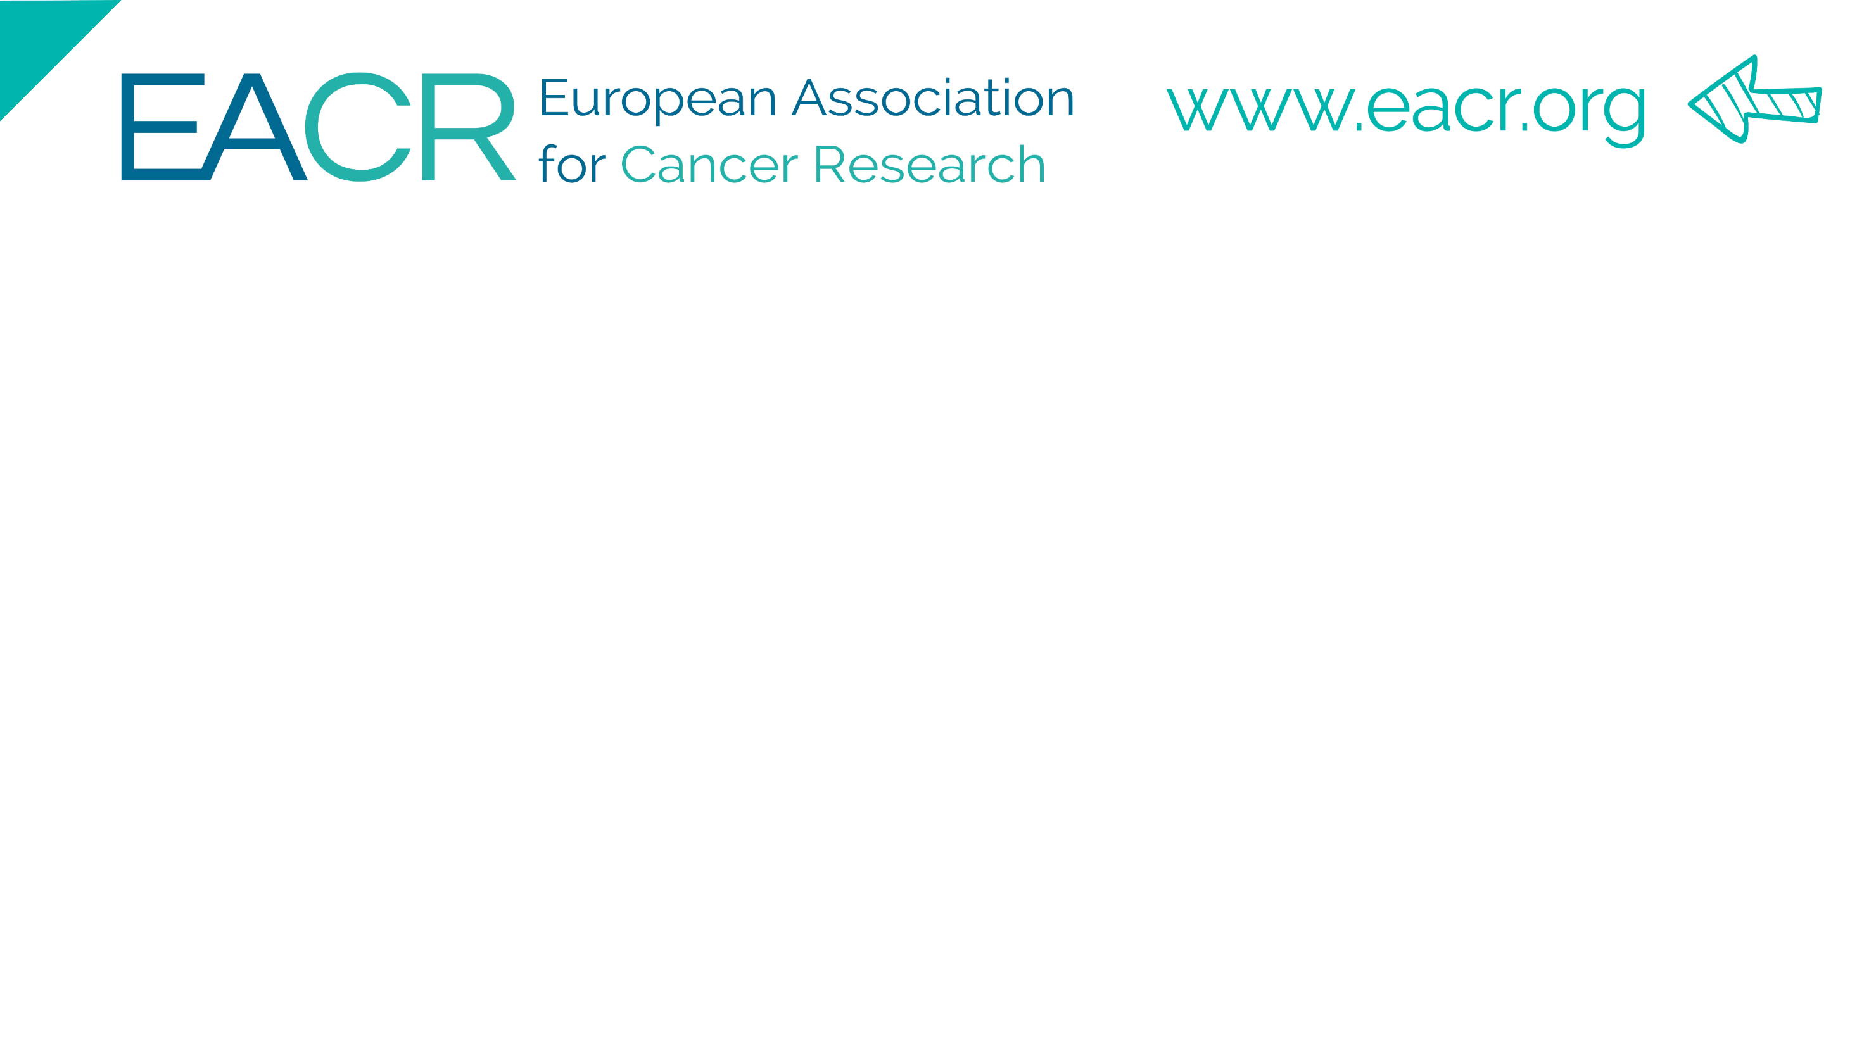
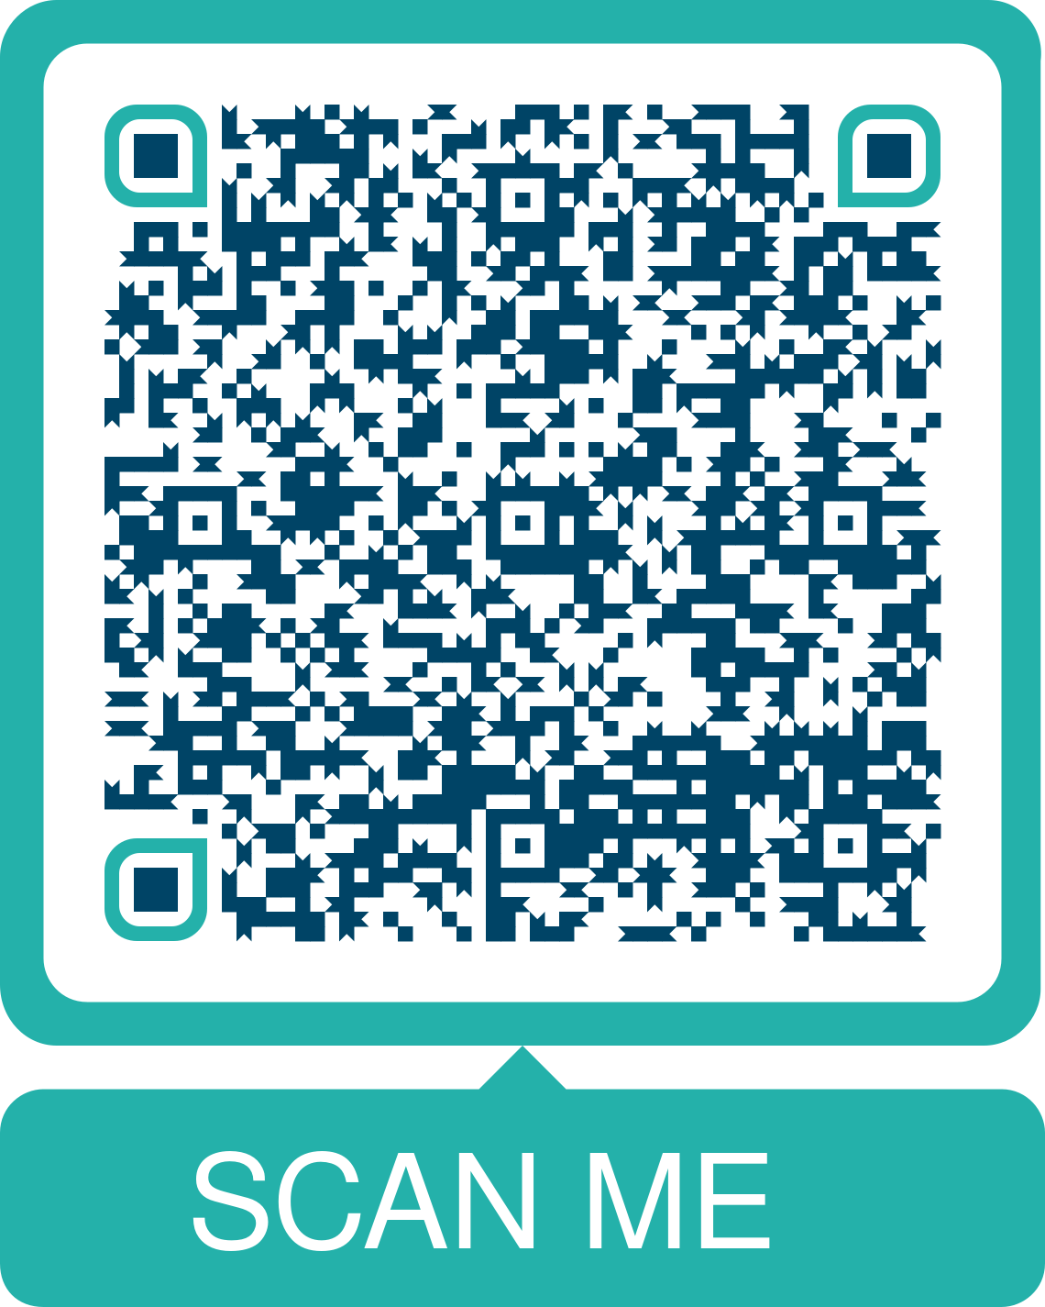
If you’re not a member yet, join us now
Our members are a supportive community of more than 14,000 cancer researchers in 115+ countries.
Communication. Collaboration. Community.
A way to bridge international borders with your lifesaving cancer research. This is what the European Association for Cancer Research (EACR) offers its members.
"EACR is one of the most sympathetic, personal, but at the same time innovative and competent international organizations for cancer researchers I know. It really shows, with everything it does, that each member matters to them." Elisa Mariella, University of Turin, Italy
Notes:
I’d like to tell you a little bit about the EACR. If you have not heard of the EACR before and you work in cancer research, I invite you to join our community. You can find out more by scanning the QR code on the screen.
We have 14,000 members worldwide – across more than 100 countries. Membership is open to anyone involved in Cancer Research – wherever they work, in any field, at any level.
We exist to support cancer researchers in their work and careers. That includes organising great conferences, providing access to different funding programmes, educational and career webinars, and tools to help network and collaborate. On top of all the tangible benefits, for many EACR members the best thing about membership is the sense of being part of an international community with the same shared goal.

Slide 2
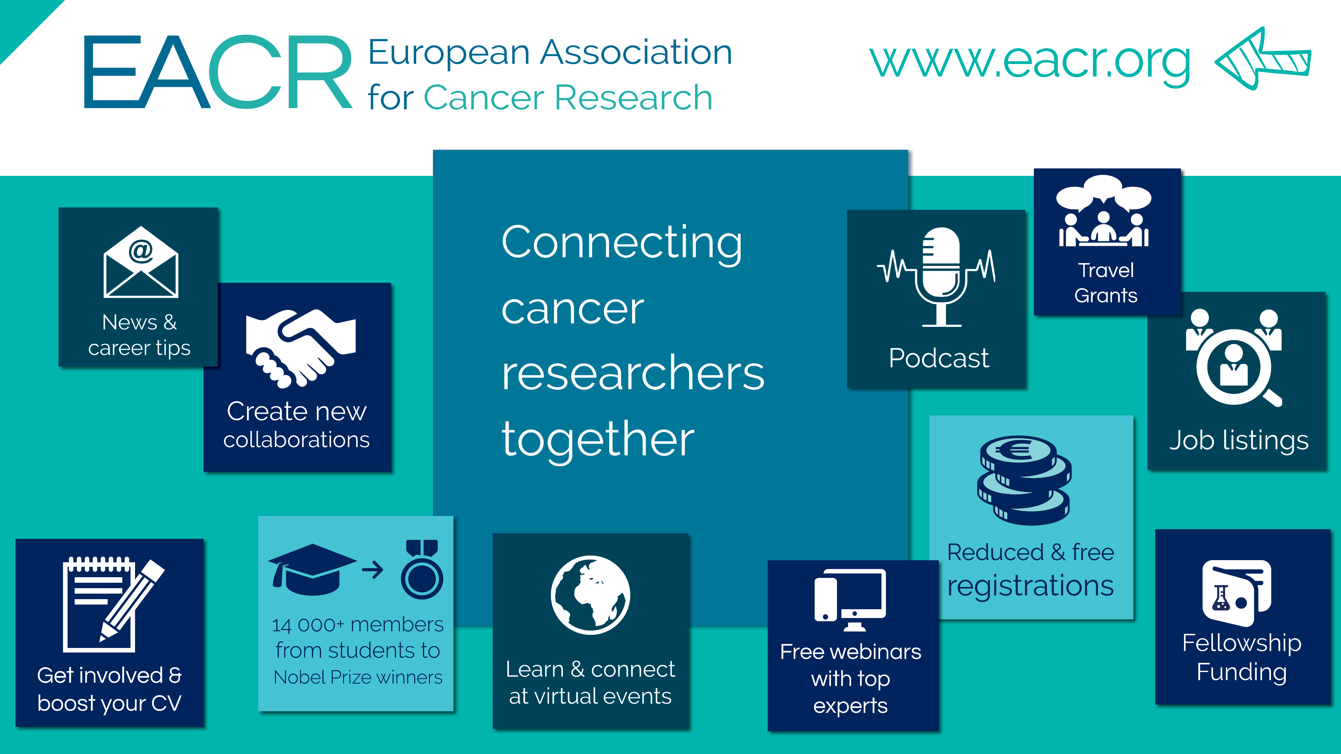

Slide 3
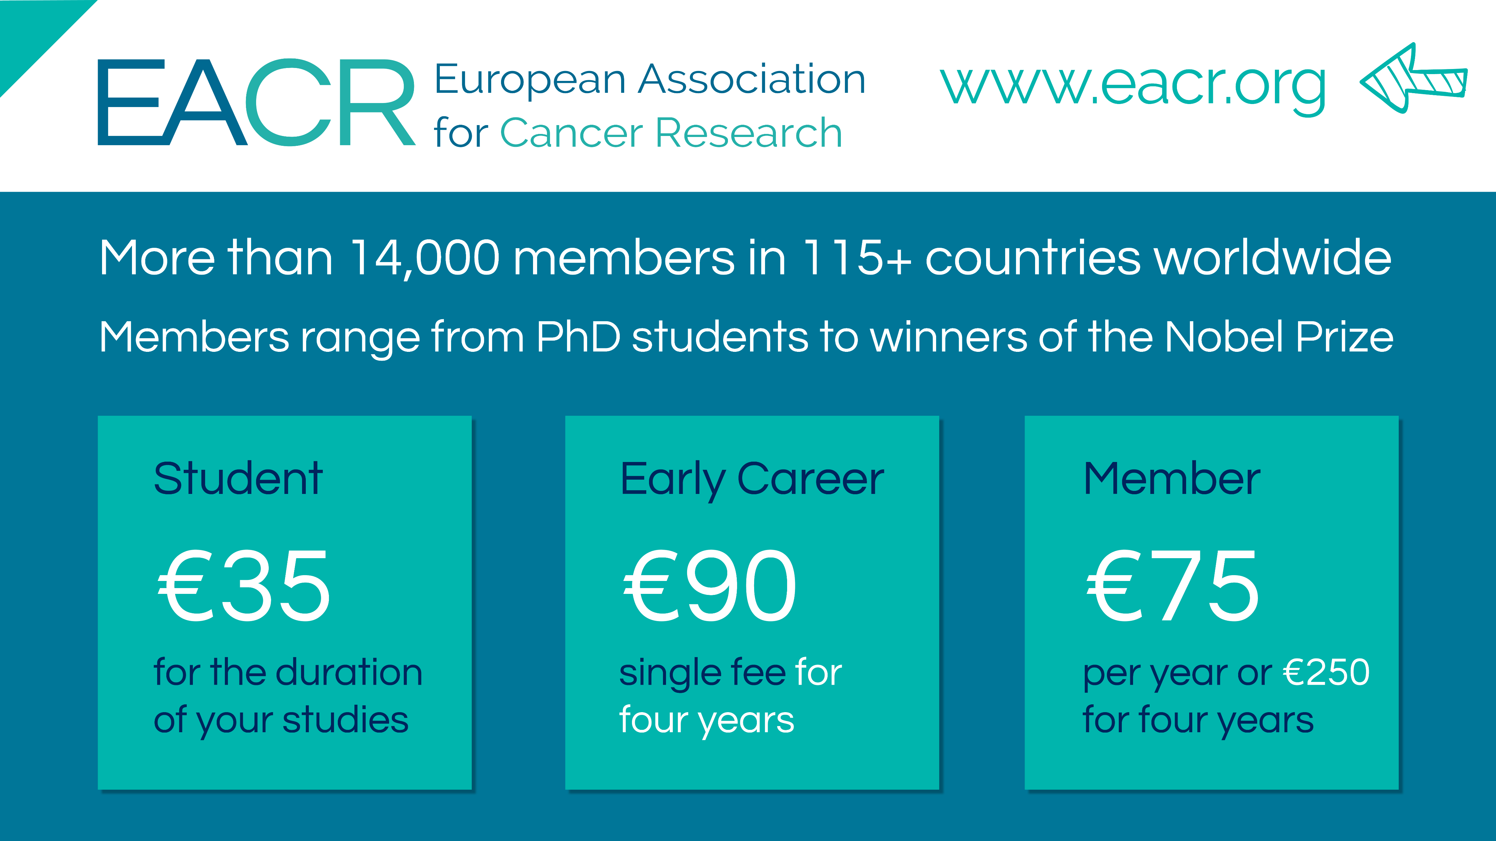
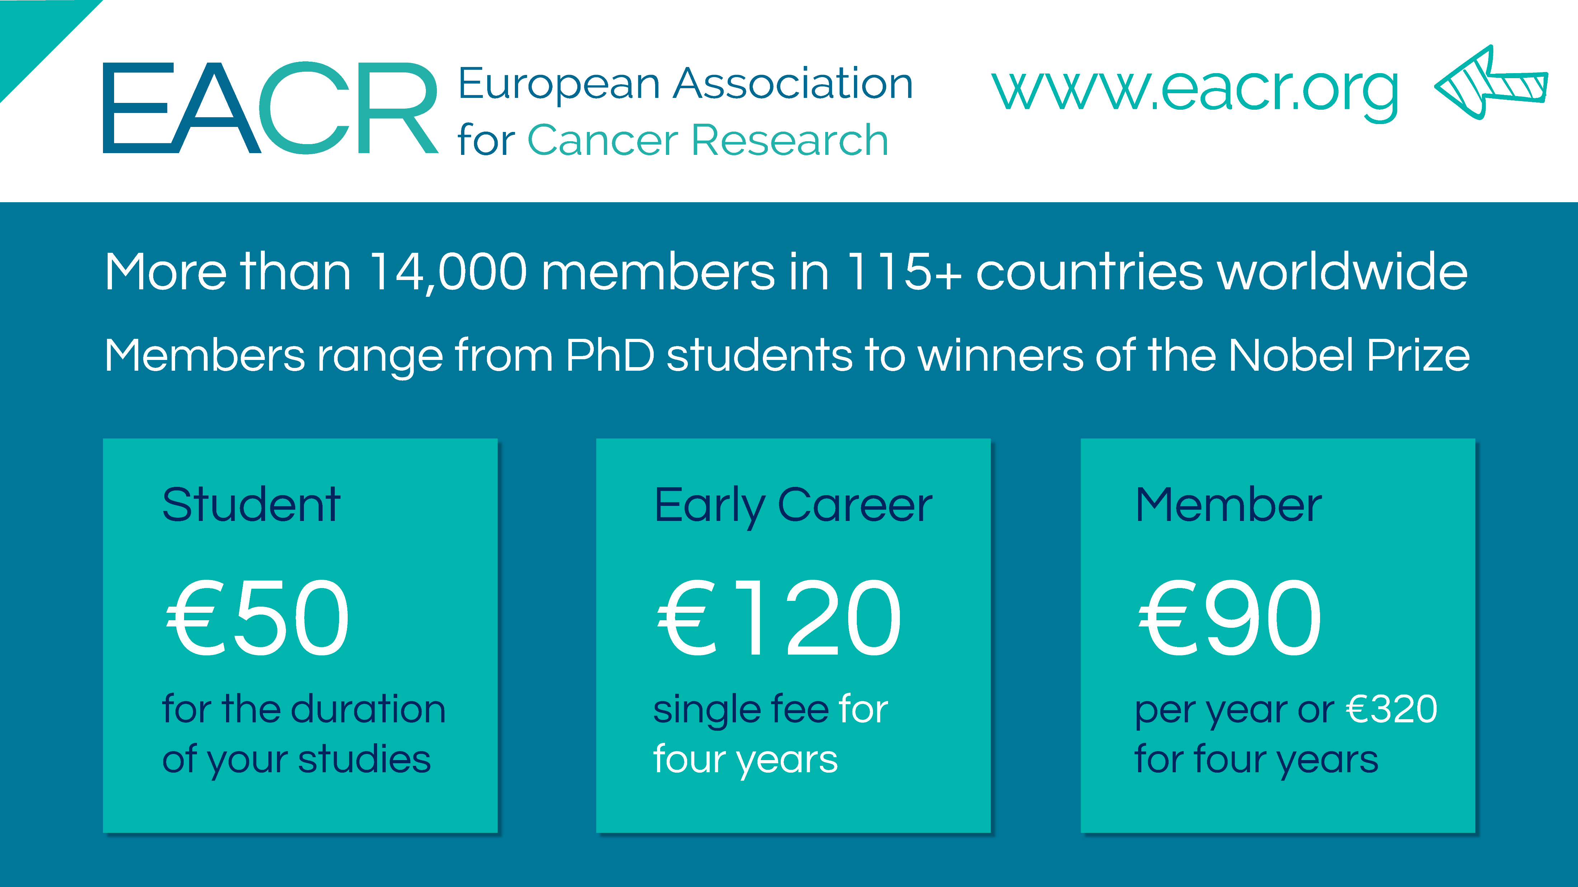

Slide 4
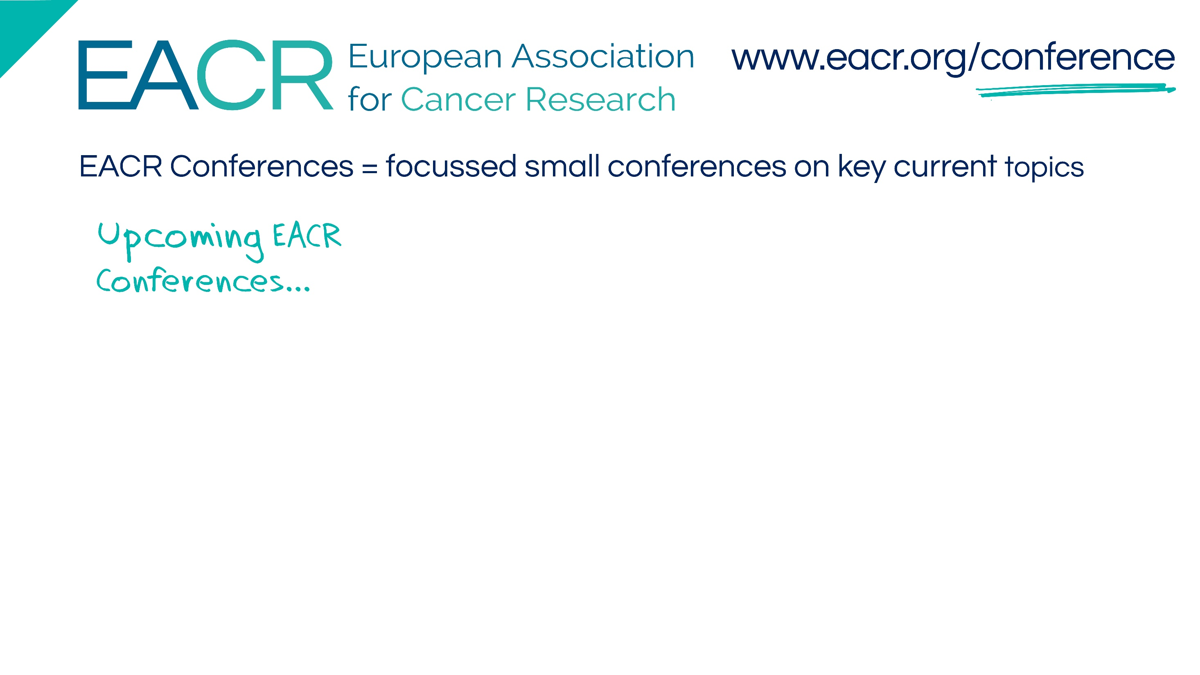

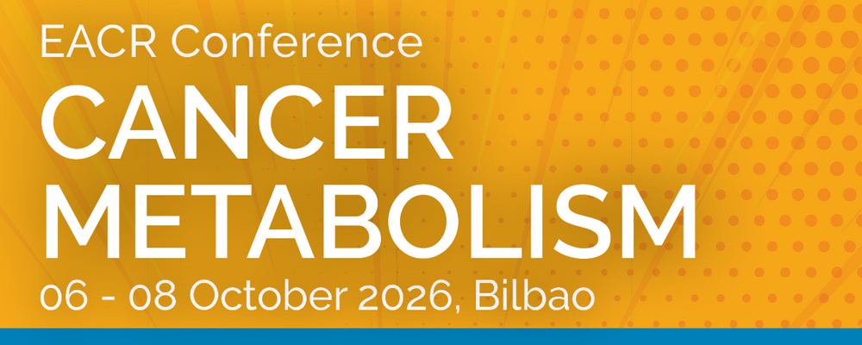

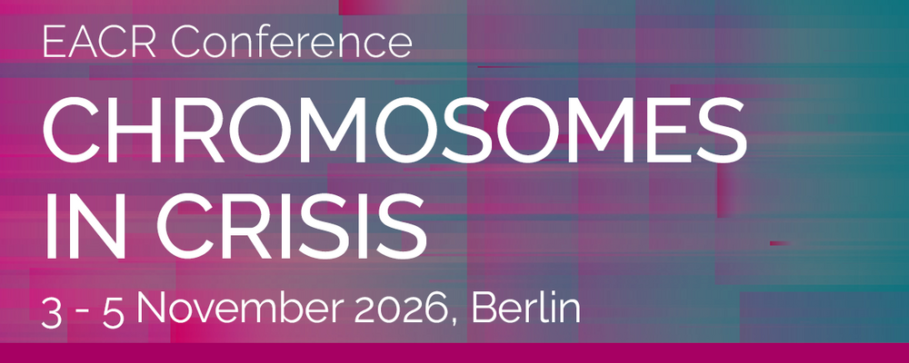

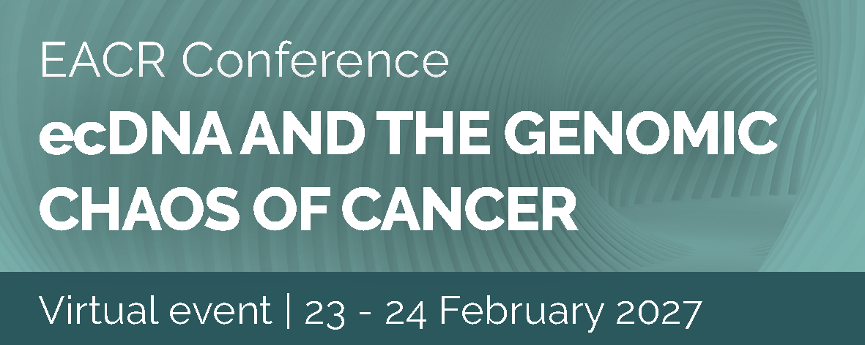
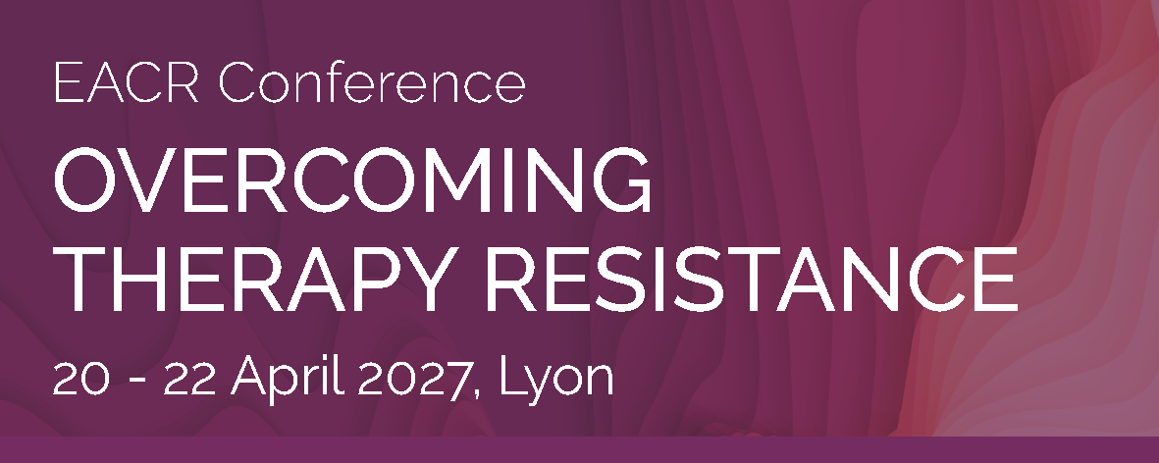
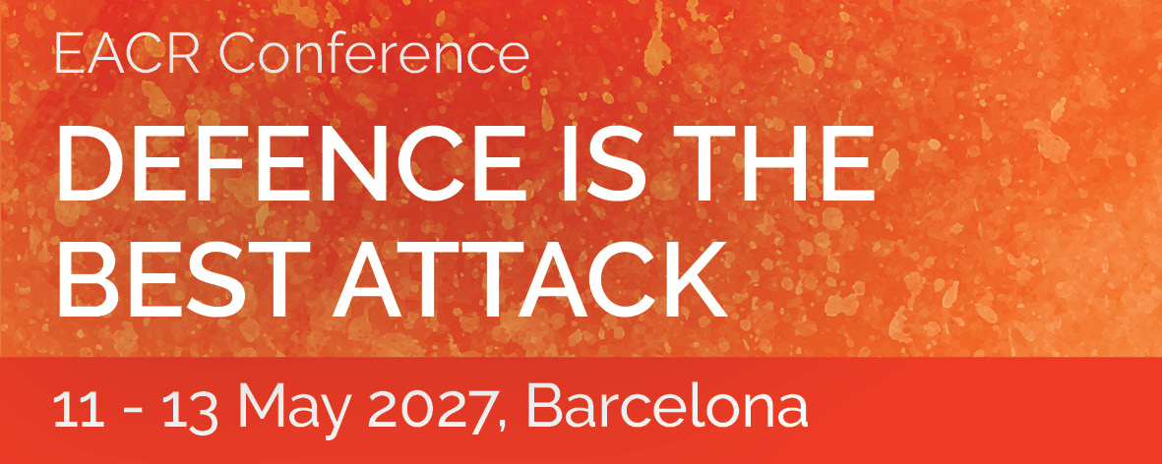
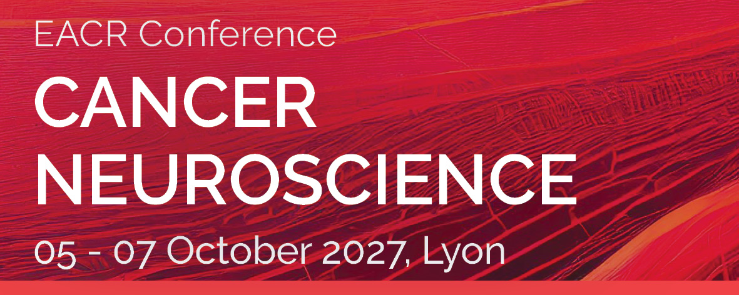
SPECIAL REDUCED REGISTRATION RATES FOR EACR MEMBERS

Slide 5
